Slide 1


Slide 2

Blockchain For Real Estate: Using Hyperledger to Replace the Mortgage Electronic Registration System M.E.R.S
A Conceptual Framework By: John Carpenter

Slide 3
John Carpenter’s Background
Co-Founder Global Blockchain Summit & Global Data Summit in October (2nd-5th) Use code data2017 for a 35% discount off of either conference.
Focused on Hyperledger & other Blockchain technologies. Run the Denver Hyperledger Meetup.
Licensed Attorney with an MBA and a Degree In Finance.
Managed the development of the real estate “Title Plant” for the real estate title insurance industry in Colorado.
Dealt with the original M.E.R.S implementation when it was first emerging in the mid to late 1990s.
Serial Entrepreneur that launched several technology ventures.
Now focused on Hyperledger & other Blockchain technologies.

Slide 4
What is Blockchain?
A Shared Ledger for recording the history of transactions that can’t be altered.
Also, there can only be one true owner of an asset written to the Blockchain, so this is perfect for an asset like a Mortgage.

Slide 5
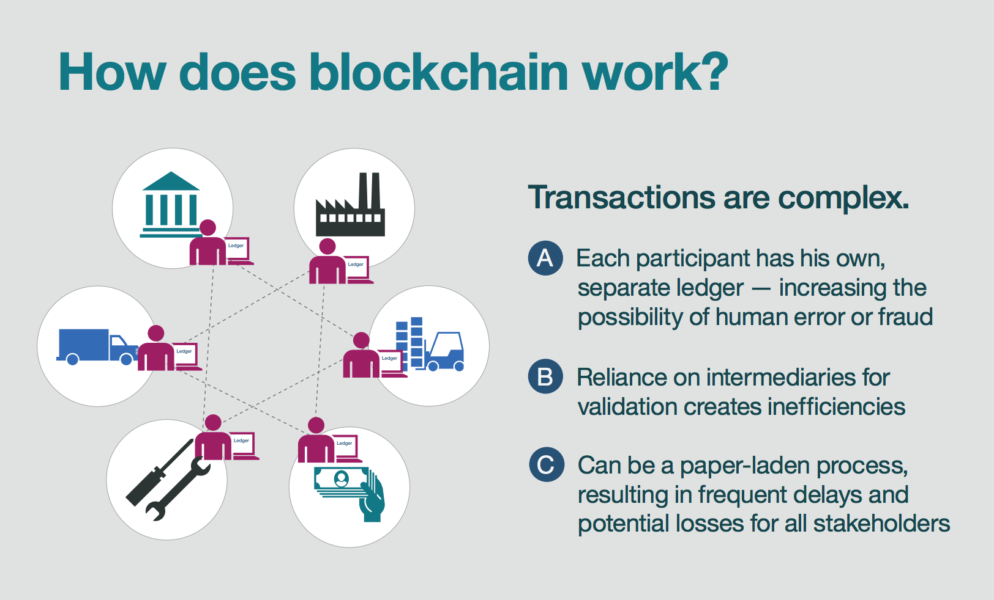
Blockchain 101

Slide 6
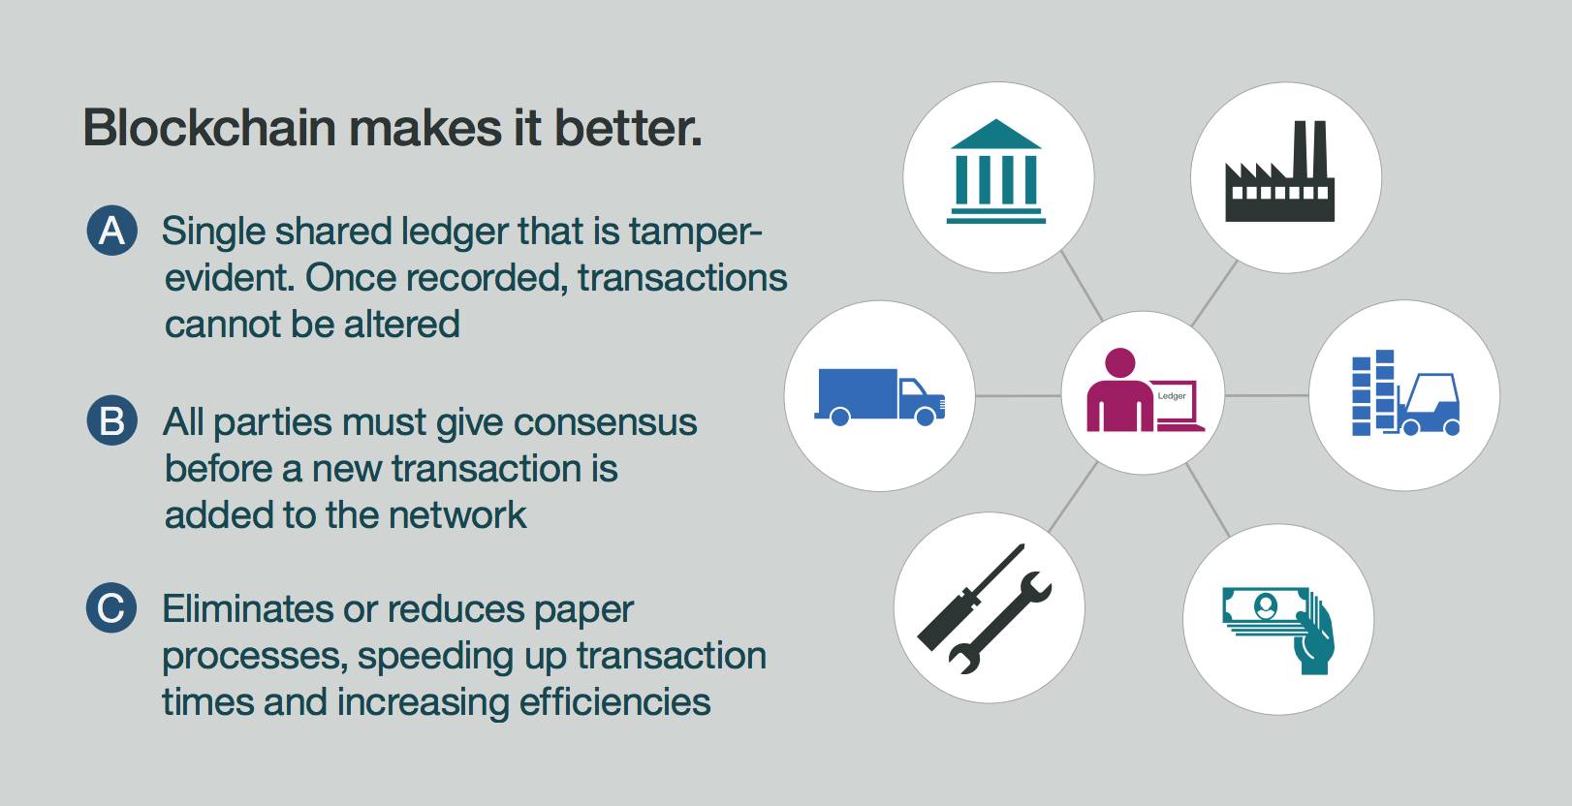
Blockchain 101

Slide 7
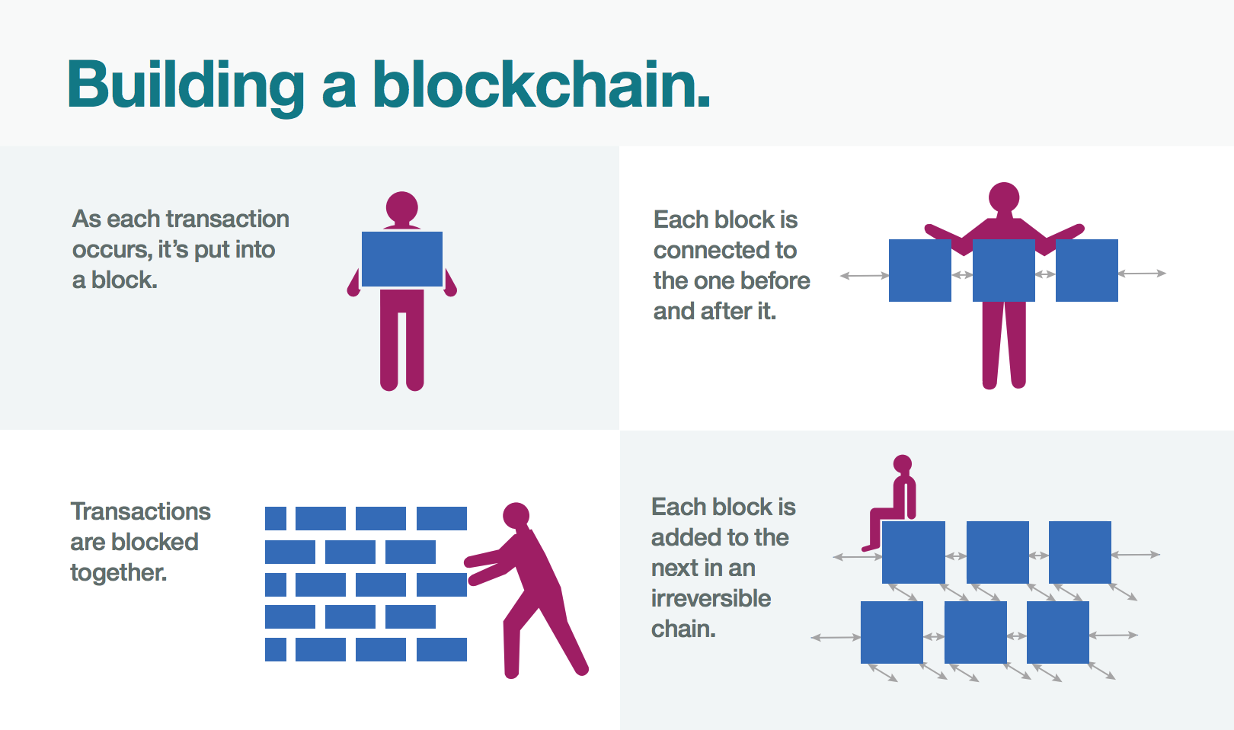
Blockchain 101

Slide 8
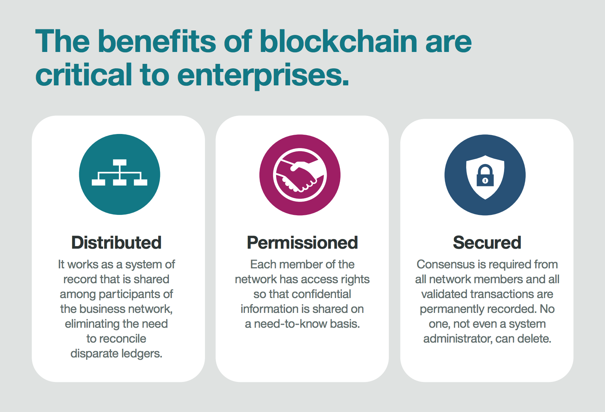
Blockchain 101

Slide 9
Hyperledger
Hyperledger is a Blockchain framework that is put out by the Linux Foundation and has been adopted by a number of major tech companies like:
IBM
Oracle
VMware

Slide 10
Overview-Mortgage Electronic Registration System (M.E.R.S.)
MERS owns and operates an electronic registry known as the MERS system, which is designed to track servicing rights and ownership of mortgages in the United States.

Slide 11
MERS History
Real estate law and real estate transactions in the US are subject to county level recordation requirements.
That made it cumbersome for financial companies to develop a smooth operation of a market based on mortgages.
Every time a mortgages is sold, state laws require that the sale of each such mortgage (or deed of trust) be recorded with the county clerk and recorder (fees).

Slide 12
MERS History (cont.)
The financial industry, wanting to trade in mortgage-backed securities, needed to find a way around these recordation requirements, and this is how the MERS system was born.
MERS replaces a public recordation with a private one.
By 2007, MERSCORP Holdings, Inc. registered some two-thirds of all the home loans in the US!

Slide 13
Subprime Crisis and Hyperledger as the Clear Solution
The role of MERS in facilitating mortgage trading was relatively uncontroversial in its early days, but continued fallout from the subprime mortgage crisis has placed the firm at the center of several legal challenges disputing the company's right to initiate foreclosures, based on confirming who currently owns the mortgage.
Adopting Blockchain (Hyperledger Fabric 1.0) would solve this problem by providing certainty as to the ownership and status of all mortgages.

Slide 14
Hyperledger (Blockchain) Mortgage Smart Contract Concept
Hyperledger would provide an immutable, security right and a transparent shared digital ledger that provides a single view of truth across all participants, while simultaneously providing selective visibility to participants based on their credentials.
It would also provide the ability to record and track events and associated payments related to the mortgage document.
No one party can modify, delete or even append any record without the consensus from others on the network.
This level of transparency helps reduce fraud and errors, as well as the need for the parties to contact each other to view mortgage and payment data and the status of a mortgage.

Slide 15
Thank You!
QUESTIONS?
Want to learn more about Blockchain or Big Data?
GlobalDataSummit.com-October 2nd & 3rd
GlobalBlockchainSummit.com-October 4th & 5th
Use code “data2017” for 35% off of either conference

